Slide 1
WEB RADIO Batch ID :190638
Team members:
1.Mesa Ubika-19BCD7176
2.Mamidala Taran-19BCE7346
3.P.Kumar Ranga Swamy-19BEC7046
4.Vivek Patric-19BCE7579
5.CH.Sobhan Babu-19BCE7614
6.G.Harika-19MIS7077
Guided by:
Prof.Aravapalli Rama Satish
Dept.of CSE

Slide 2
Agenda
Introduction
Raspberry Pi
Abstract
Module Identification
Architecture Diagram
Equipment Identified
References

Slide 3
1. Introduction
Internet radio which is also known as web radio, is a service which provides receiving and
playing audio data originating from the internet.
This requires a technical features which allows audio to be digitized and split into small
pieces for transmission across the Internet.
Internet radio services are usually accessible from anywhere in the world and the quality
of these services do not degrade over distance.
These features have made Internet radio service popular among radio providers. The
movement from traditional radio broadcasting to the Internet radio service is also
evident in cell phone industry.
Most of mobile phone manufacturers no more integrate their new products with
traditional radio receivers.
Instead, they simply provide a program which enables receiving radio channels via the
internet connection.

Slide 4
2.Abstract
Internet based radio services has become increasingly popular over the
last few years for listening to radio channels.
This services offer continuous stream of audio accessible from all around the world.
The wide deployment of Internet access with high reliability has made the radio
streaming available for various devices.
While traditional radio stations are subject to extensive government regulations, Internet
radio stations remain largely unregulated.
In addition, establish a new channel through the online streaming is less costly compared
to broadcasting in a traditional way.

Slide 5
3.Module Identification
Installing Pi Music box and extracting the contents of the zip file.
Flashing the image file of the pi music box into the SD card using etcher.
Open settings file and entering WIFI network credentials.
Inserting SD card into Raspberry pi and open Pi music box by entering the IP address of the Pi in the browser.
Stream your music from Spotify, Google Music, SoundCloud, Webradio(with TuneIn, Dirble, AudioAddict, Soma FM directories), Podcasts and other music from the cloud. Or from your own collection from a device in your network.

Slide 6
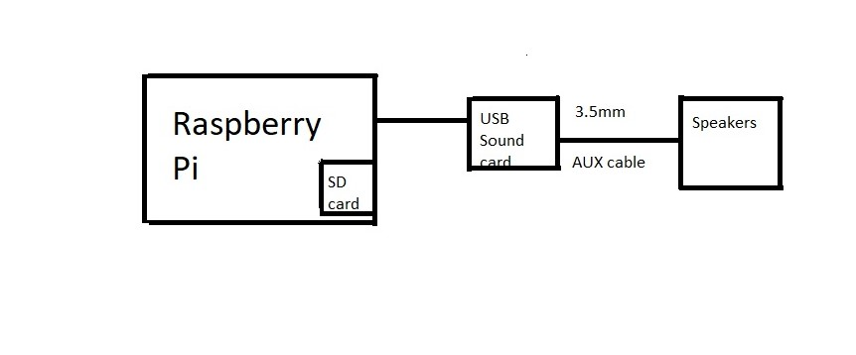
4.Architecture Diagram

Slide 7
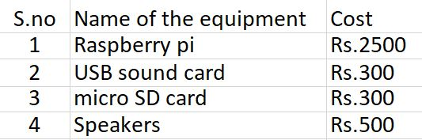
Equipment

Slide 8
.References
https://www.pimusicbox.com/
2. https://www.youtube.com/watch?v=aSga6w89VpI&list=WL&index=2&t=114s

